Slide 1
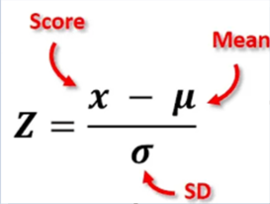
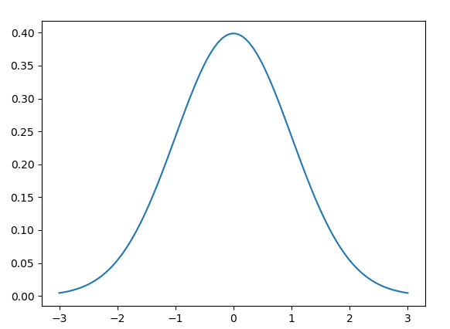
LINEAR REGRESSION
Artificial Intelligence And Machine Learning
FEATURE SCALING / NORMALIZATION
Feature Scaling is to bring values of our input in a small similar range to allow efficient gradient descent.
Z - Score Normalization
We normalize the input data using the mean and standard deviation of the entire training set
The formula for this is: After normalization, our data takes the form of a bell curve or guassian distribution:

Slide 2
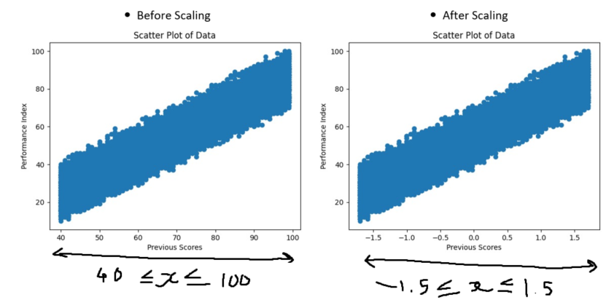
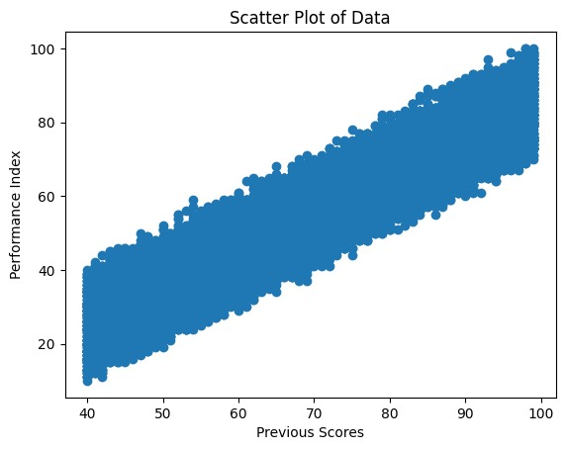

LINEAR REGRESSION
Artificial Intelligence And Machine Learning
FEATURE SCALING
Before Scaling
After Scaling

Slide 3
LINEAR REGRESSION
Artificial Intelligence And Machine Learning
MULTIPLE LINEAR REGRESSION – PREDICTION FUNCTION
We have seen that the prediction function in single linear regression is:
f_wb(x) = wx + b
This is because for our input, we only have one feature (column). Example:
Student Performance | Student Performance
Index (i) | Previous score x (input) | Predicted Score y (output)
1 | 99 | 91
2 | 51 | 45

Slide 4
LINEAR REGRESSION
Artificial Intelligence And Machine Learning
MULTIPLE LINEAR REGRESSION – PREDICTION FUNCTION
In multiple linear regression, instead of having only one feature, we have multiple features i.e., more than 1 feature or column for our input. Example:
Student Performance | Student Performance
 | X (input) |  |  |  |  | y (output)
Index (i) | Hours Studied | Previous Scores | Extracurricular Activities | Sleep Hours | Sample Question Papers Practiced | Predicted Score
1 | 7 | 99 | Yes | 9 | 1 | 91
2 | 4 | 82 | No | 4 | 2 | 65

Slide 5
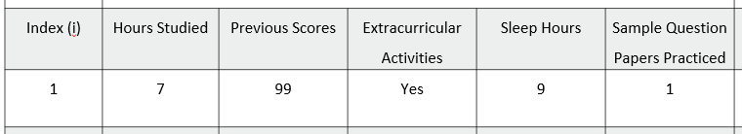
LINEAR REGRESSION
Artificial Intelligence And Machine Learning
MULTIPLE LINEAR REGRESSION – PREDICTION FUNCTION
This means, our input is now not only a single value, but a collection of values that represent different things like hours studied, previous scores, etc.
So, our input is now not a scalar value, but a vector. In simple terms, our input X is now an array of a single training example. Example:
For training example 1, X = [7, 99, Yes, 9, 1], having values for all the features.
This means, for each feature, there will be a corresponding weight value to be multiplied with it, meaning our weight w is also a vector now with 5 weights.

Slide 6
LINEAR REGRESSION
Artificial Intelligence And Machine Learning
MULTIPLE LINEAR REGRESSION – PREDICTION FUNCTION
Revisiting our prediction function, we now have:
f_wb(X) = W.X + b
where,
W = weight vector
X = input vector
W.X = dot product of W and X
b = bias
meaning on expanding the function, we get:
f_wb(X) = w[1]X[1] + w[2]X[2] + w[3]X[3] + ….. + w[n]X[n] + b

Slide 7
